Slide 1
9
Net Present Value and Other Investment Criteria

Slide 2

Chapter 9 – Index of Sample Problems
Slide # 02 - 04 Net present value
Slide # 05 - 06 Payback
Slide # 07 - 08 Discounted payback
Slide # 09 - 10 Average accounting return
Slide # 11 - 12 Internal rate of return
Slide # 13 - 16 Crossover point
Slide # 17 - 19 Profitability index
Slide # 20 - 22 Mutually exclusive projects
Slide # 23 - 24 Multiple independent projects

Slide 3
2: Net present value
You are considering a project which requires an initial investment of $24,000. The project will produce cash inflows of $8,000, $9,800, $7,600 and $6,900 over the next four years, respectively.
What is the net present value of this project if the required rate of return is 12%?
Should this project be accepted?

Slide 4
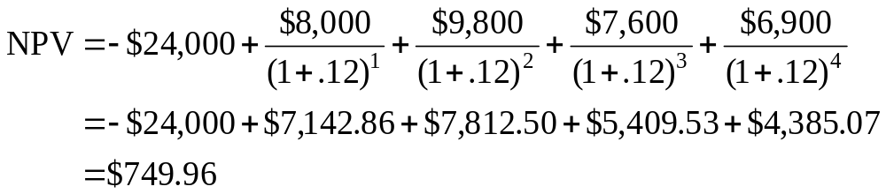
3: Net present value

Slide 5
4: Net present value
CF₀ = -$24,000
CO₁ = $ 8,000 FO₁ = 1
CO₂ = $ 9,800 FO₂ = 1
CO₃ = $ 7,600 FO₃ = 1
CO₄ = $ 6,900 FO₄ = 1
I = 12%
NPV CPT
$749.96

Slide 6
5: Payback
A project has an initial cost of $199,000. The project produces cash inflows of $46,000, $54,000, $57,500, $38,900 and $46,500 over the next five years, respectively.
What is the payback period for this project?
Should the project be accepted if the required payback period is 3 years?

Slide 7
6: Payback
Year Cash flow Cumulative cash flow
1 $46,000 $ 46,000
2 $54,000 $100,000
3 $57,500 $157,500
4 $38,900 $196,400
5 $46,500 $242,900

Slide 8
7: Discounted payback
A project has an initial cost of $200,000 and produces cash inflows of $86,000, $93,600, $42,000 and $38,000 over the next four years, respectively.
What is the discounted payback period if the discount rate is 10%?
Should this project be accepted if the required discounted payback period is 3 years?

Slide 9
8: Discounted payback
Year Discounted Cumulative discounted
cash flow cash flow
1 $86,000/(1+.10)¹ = $78,181.82 $ 78,181.82
2 $93,600/(1+.10)² = $77,355.37 $155,537.19
3 $42,000/(1+.10)³ = $31,555.22 $187,092.41
4 $38,000/(1+.10)⁴ = $25,954.51 $213,046.92

Slide 10
9: Average accounting return
A project has an initial cost of $134,000 for equipment. This equipment will be depreciated using straight line depreciation to a zero book value over the four year life of the project. The project is expected to produce annual net income of $4,700, $5,100, $5,800 and $6,500 over the four years, respectively.
What is the average accounting return (AAR)?
Should this project be accepted if the required AAR is 8%?

Slide 11
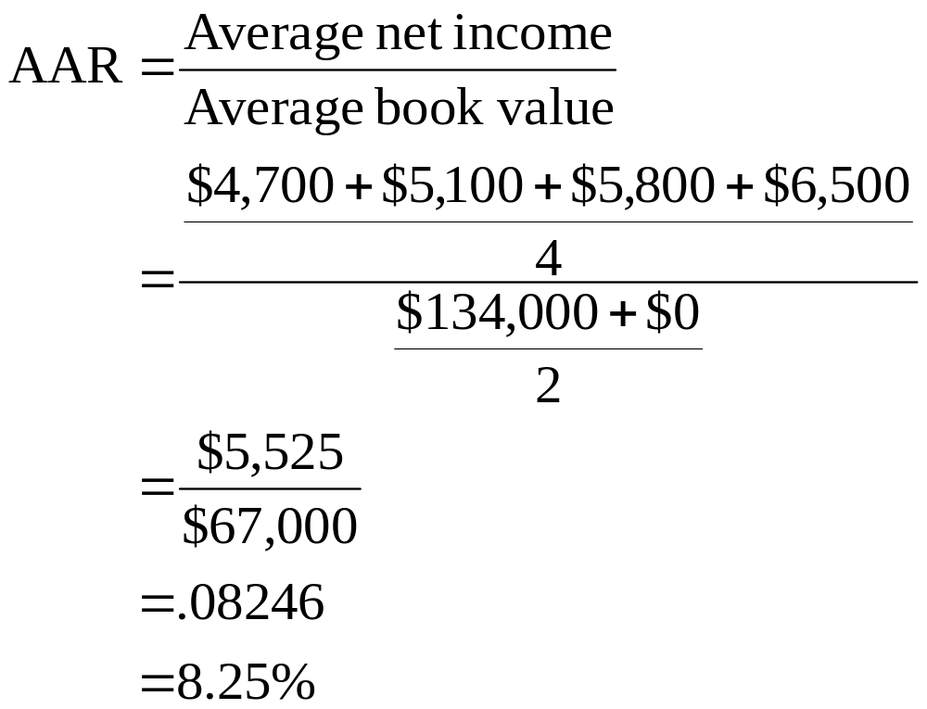
10: Average accounting return

Slide 12
11: Internal rate of return
You are considering a project with an initial cost of $48,500. The project has a five year life and produces cash inflows of $9,800, $12,200, $12,850, $13,200 and $13,600 over the five years, respectively.
What is the internal rate of return on this project?
Should this project be accepted if the required rate of return is 8%?

Slide 13
12: Internal rate of return
CF₀ = -$48,500
CO₁ = $ 9,800 FO₁ = 1
CO₂ = $12,200 FO₂ = 1
CO₃ = $12,850 FO₃ = 1
CO₄ = $13,200 FO₄ = 1
CO₅ = $13,600 FO₅ = 1
IRR CPT
8.14%

Slide 14
13: Crossover point
You are considering two projects with the following cash flows:
Year Project A Project B
0 -$32,000 -$30,000
1 $12,000 $11,500
2 $17,600 $16,700
3 $20,900 $19,200
What is the crossover point?
Which project should be accepted if the discount rate is 12%?

Slide 15
14: Crossover point
Year A B A - B
0 -$32,000 -$30,000 -$2,000
1 $12,000 $11,500 $ 500
2 $17,600 $16,700 $ 900
3 $20,900 $19,200 $1,700
CF₀ = -$2,000
CO₁ = $ 500 FO₁ = 1
CO₂ = $ 900 FO₂ = 1
CO₃ = $1,700 FO₃ = 1
IRR CPT
20.6682% or 20.67%

Slide 16
15: Crossover point
Year A
0 -$32,000
1 $12,000
2 $17,600
3 $20,900
CF₀ = -$32,000
CO₁ = $12,000 FO₁ = 1
CO₂ = $17,600 FO₂ = 1
CO₃ = $20,900 FO₃ = 1
I = 20.6682%
NPV CPT
$1,926.95
Year B
0 -$30,000
1 $11,500
2 $16,700
3 $19,200
CF0 = -$30,000
CO1 = $11,500 FO1 = 1
CO2 = $16,700 FO2 = 1
CO3 = $19,200 FO3 = 1
I = 20.6682%
NPV CPT
$1,926.95

Slide 17
16: Crossover point
Year A
0 -$32,000
1 $12,000
2 $17,600
3 $20,900
CF₀ = -$32,000
CO₁ = $12,000 FO₁ = 1
CO₂ = $17,600 FO₂ = 1
CO₃ = $20,900 FO₃ = 1
I = 12%
NPV CPT
$7,621.11
Year B
0 -$30,000
1 $11,500
2 $16,700
3 $19,200
CF0 = -$30,000
CO1 = $11,500 FO1 = 1
CO2 = $16,700 FO2 = 1
CO3 = $19,200 FO3 = 1
I = 12%
NPV CPT
$7,247.18

Slide 18
17: Profitability index
The project you are considering has cash inflows of $4,800, $6,400 and $8,200 over the three year life of the project. The initial cash requirement is $13,600.
What is the profitability index if the discount rate is 9%?
Should this project be accepted if the discount rate is 9%?

Slide 19
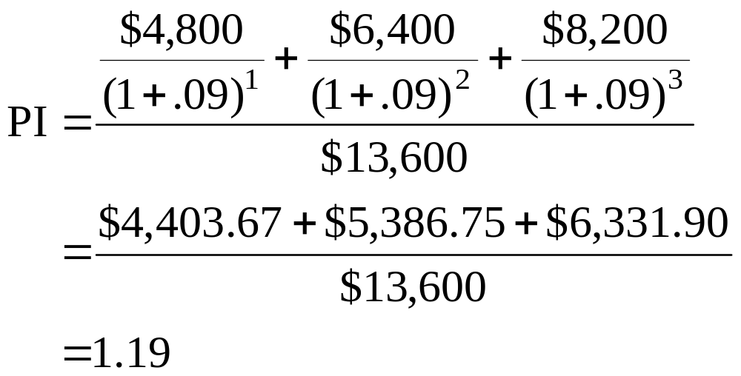
18: Profitability index

Slide 20
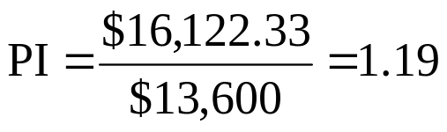
19: Profitability index
CF₀ = $ 0
CO₁ = $4,800 FO₁ = 1
CO₂ = $6,400 FO₂ = 1
CO₃ = $8,200 FO₃ = 1
I = 9%
NPV CPT
$16,122.33

Slide 21
20: Mutually exclusive projects
You are considering two mutually exclusive projects which have the following cash flows:
Year Project A Project B
0 -$48,000 -$50,000
1 $16,000 $21,000
2 $20,400 $21,000
3 $25,700 $28,000
The required return is 11%.
Should you use NPV or IRR to determine which project to accept?
Which project should be accepted?

Slide 22
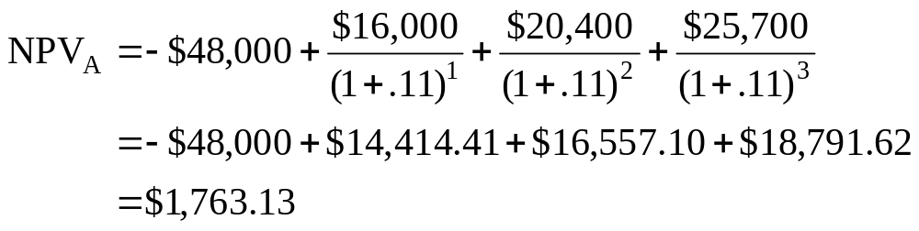
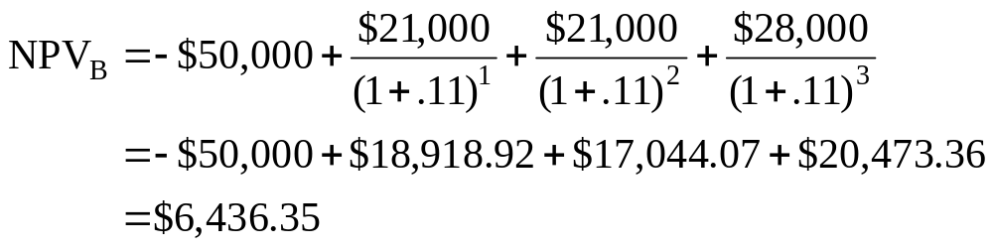
21: Mutually exclusive projects

Slide 23
22: Mutually exclusive projects
Project A:
CF₀ = -$48,000
CO₁ = $16,000 FO₁ = 1
CO₂ = $20,400 FO₂ = 1
CO₃ = $25,700 FO₃ = 1
I = 11%
NPV CPT
$1,763.13
Project B:
CF₀ = -$50,000
CO₁ = $21,000 FO₁ = 2
CO₂ = $28,000 FO₂ = 1
I = 11%
NPV CPT
$6,436.35

Slide 24
23: Multiple independent projects
A company has compiled the following data on four independent projects:
A B C D
NPV $3,838 $4,607 $4,908 $4,202
PI 1.36 1.20 1.02 1.06
The company only has funds to finance two of the projects.
Which two projects should be financed?

Slide 25
24: Multiple independent projects
A B C D
NPV $3,838 $4,607 $4,908 $4,202
PI 1.36 1.20 1.02 1.06
Given that the projects are independent, your best choice, given the information provided, is to select the projects with the highest profitability index (PI) values. Thus, you should select projects A and B as they return more per dollar spent.

Slide 26
9
End of Chapter 9

